Slide 1
Paul Baay, President & CEO

Slide 2

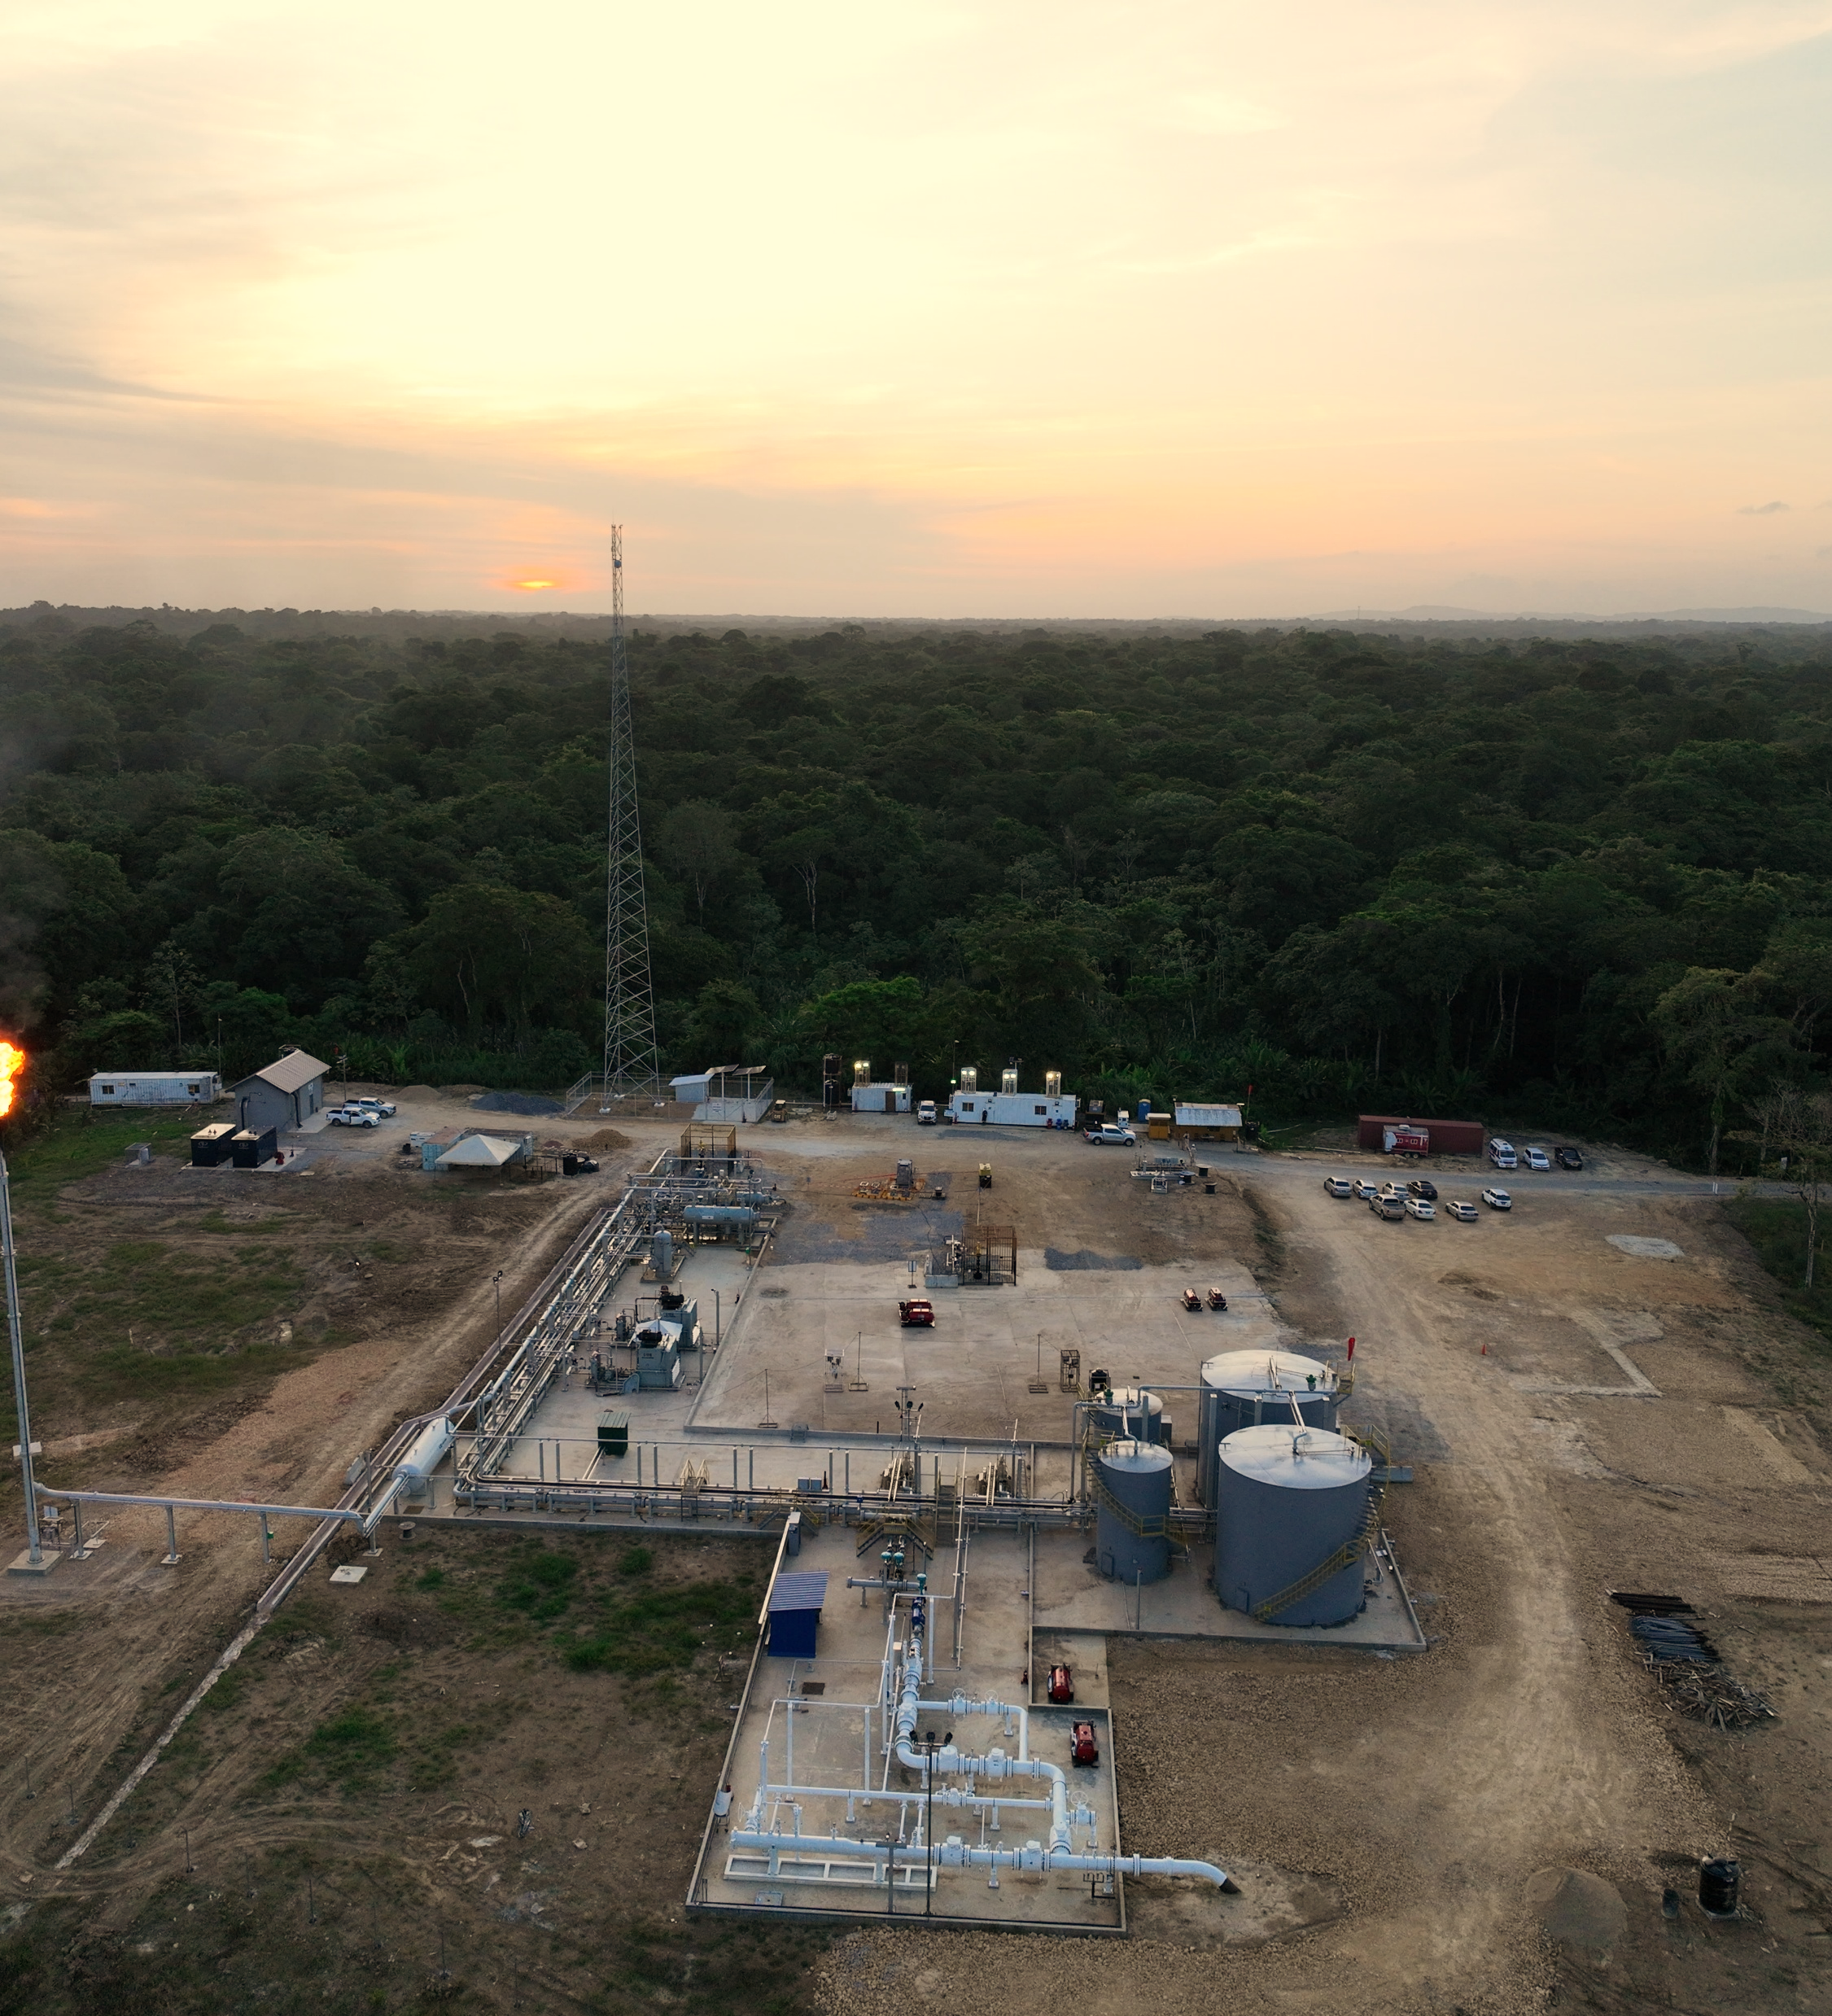
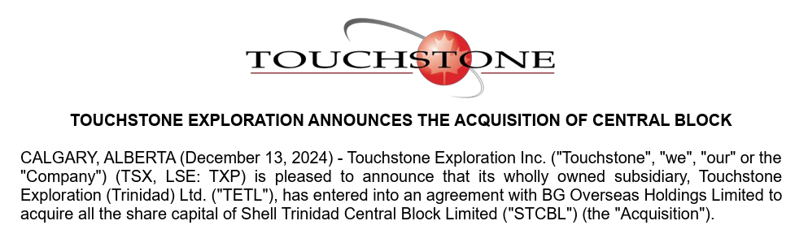
Touchstone at a Glance
Largest independent onshore producer in Trinidad
Market capitalization⁽¹⁾ | C$108.8 million
Nine months ended September 30, 2024 average daily production
Crude oil and liquids (bbls/d) | 1,325
Natural gas (Mcf/d) | 27,349
Average daily production (boe/d) | 5,883
2023 Gross 2P reserves⁽²⁾ (Mboe) | 67,379
2P Reserve life index⁽²⁾ | ~14.4 years
Notes:
Based on 236,460,661 outstanding shares multiplied by the closing share price on the TSX on December 31, 2024, being C$0.46 per share.
Based on the December 31, 2023 GLJ Ltd. independent reserves evaluation. Gross reserves are the Company's working interest share before the deduction of royalties. See "Advisories: Oil and Gas Reserves" and "Advisories: Oil and Gas Measures".

Slide 3
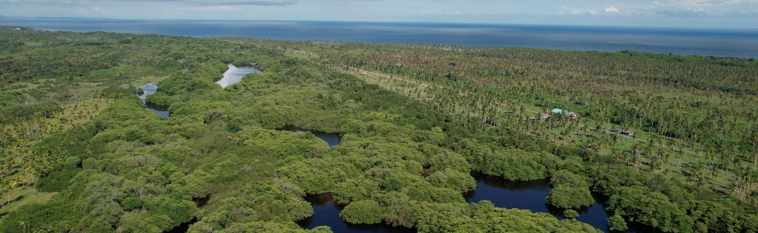
WHERE WE HAVE BEEN
We have been putting the pieces together

Slide 4

Where We Have Been: Land and capital expenditures
Note:
Non-GAAP financial or other measure. Refer to "Advisories: Non-GAAP Financial Measures".
Notes:
MIKE TO ADJUST Y AXIS FOR LAND HOLDINGS

Slide 5
Where We Have Been: Funds flow from operations and net earnings per share
Note:
Basic and diluted per share information.
Notes:
Footnote at the title

Slide 6
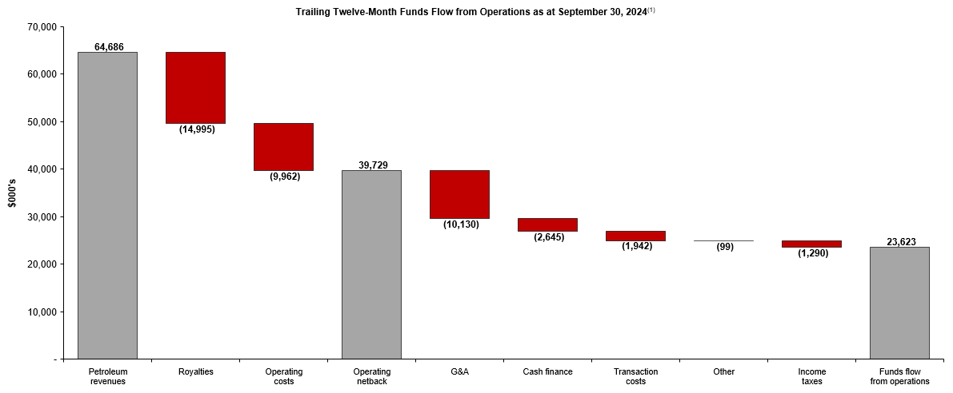
Where We Have Been: Trailing twelve-month funds flow from operations
(2)
(2)
Notes:
Financial figures above represent unaudited trailing twelve-month figures as at September 30, 2024, being the sum of results during the nine months ended September 30, 2024 and the October 1, 2023 through December 31, 2023 interim period.
Non-GAAP financial or other measure. Refer to "Advisories: Non-GAAP Financial Measures".

Slide 7
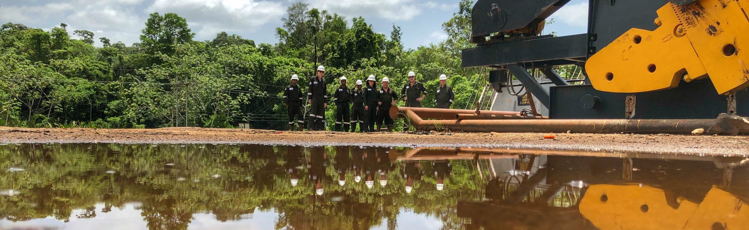
WHERE WE ARE NOW
We have been evolving and growing

Slide 8
Where We Have Been: Corporate net production
Notes:
Colleen fixing gap

Slide 9

Production History: Herrera (Coho)
Cumulative production
3.4 Bcf natural gas
Inception to date operating netback⁽¹⁾ as at September 30, 2024 = $2.9MM
Note:
Non-GAAP financial or other measure. Refer to "Advisories: Non-GAAP Financial Measures". Represents Touchstone's net operating netback from October 2022 through September 30, 2024.
Notes:
FIX END DATE SEPT

Slide 10
Production History: Herrera (Cascadura facility)
Cumulative production
14.3 Bcf natural gas
138.9 Mbbl condensate
Downtime in October 2024 related to Cascadura C tie-in
Inception to date operating netback⁽¹⁾ as at
September 30, 2024 = $28.9MM
Inception to date capital expenditures⁽¹⁾⁽²⁾ as at
September 30, 2024 = $26.0MM
Notes:
Non-GAAP financial or other measure. Refer to "Advisories: Non-GAAP Financial Measures". Represents Touchstone's net operating netback from September 2023 through September 30, 2024 and net capital expenditures incurred from July 2019 through September 30, 2024.
Capital expenditures related to Cascadura-1ST1, Cascadura Deep-1 and Cascadura A facility.
Notes:
FIX END DATE SEPT

Slide 11
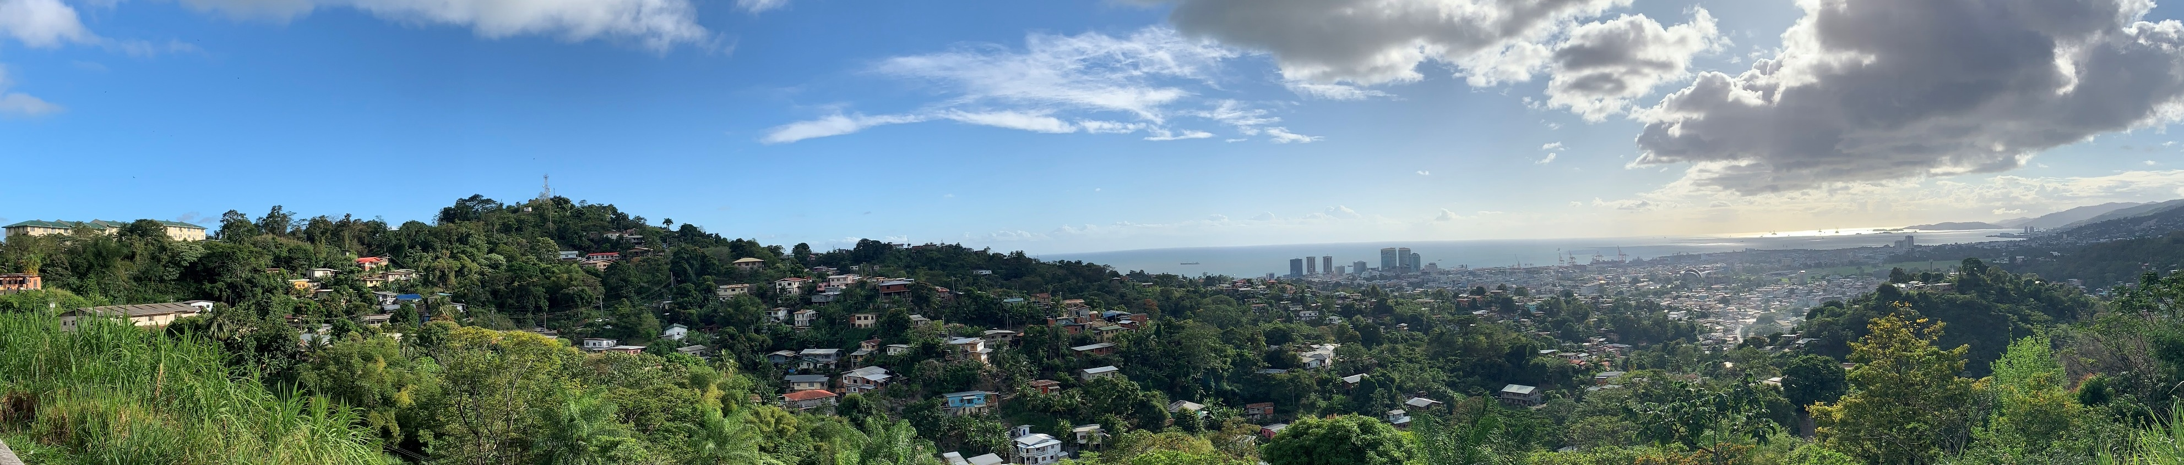
WHERE WE ARE GOING
We are ready

Slide 12

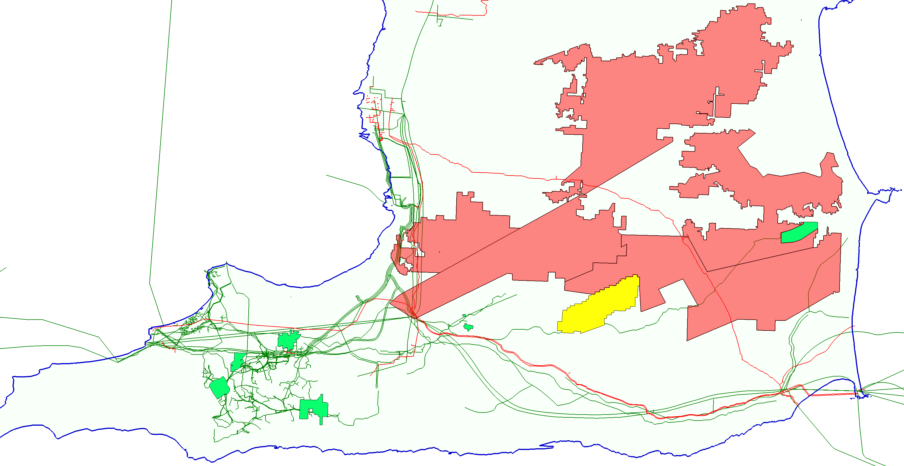
Acreage: We have the land
Touchstone Today
8 core properties
100% operated
81% average W.I.
144,893 net acres
Charuma
Exploration
72,784 acres (58,227 net)
TXP: 80% working interest
NGC: 20% working interest
Cretaceous prospectivity
Rio Claro
Exploration and Development
31,983 acres (25,586 net)
TXP: 80% working interest
NGC: 20% working interest
Herrera, Cretaceous and Nariva prospectivity
Cipero
Exploration
29,924 acres (23,939 net)
TXP: 80% working interest
NGC: 20% working interest
Herrera and Cretaceous prospectivity
2025 Acquisition
Shell Central Block
100% operated
65% W.I.
4,354 net acres
Balata East
Development
1,270 acres
TXP: 100% working interest
Herrera oil production
Ortoire
Exploration and Development
40,644 acres (32,516 net)
TXP: 80% working interest
HPCL: 20% working interest
Herrera and Cretaceous prospectivity
Coho gas production - 2022
Cascadura gas production - 2023
Cascadura gas expansion - 2024
WD-4
Development
700 acres
TXP: 100% working interest
Forest and Cruse production
WD-8
Development
650 acres
TXP: 100% working interest
Forest and Cruse production
CO-1
Development
1,230 acres
TXP: 100% working interest
Forest and Cruse production
2025 Acquisition
Central Block
Development
6,699 acres (4,354 net)
65% working interest
Herrera production
Notes:
Define who NGC and HPCL

Slide 13

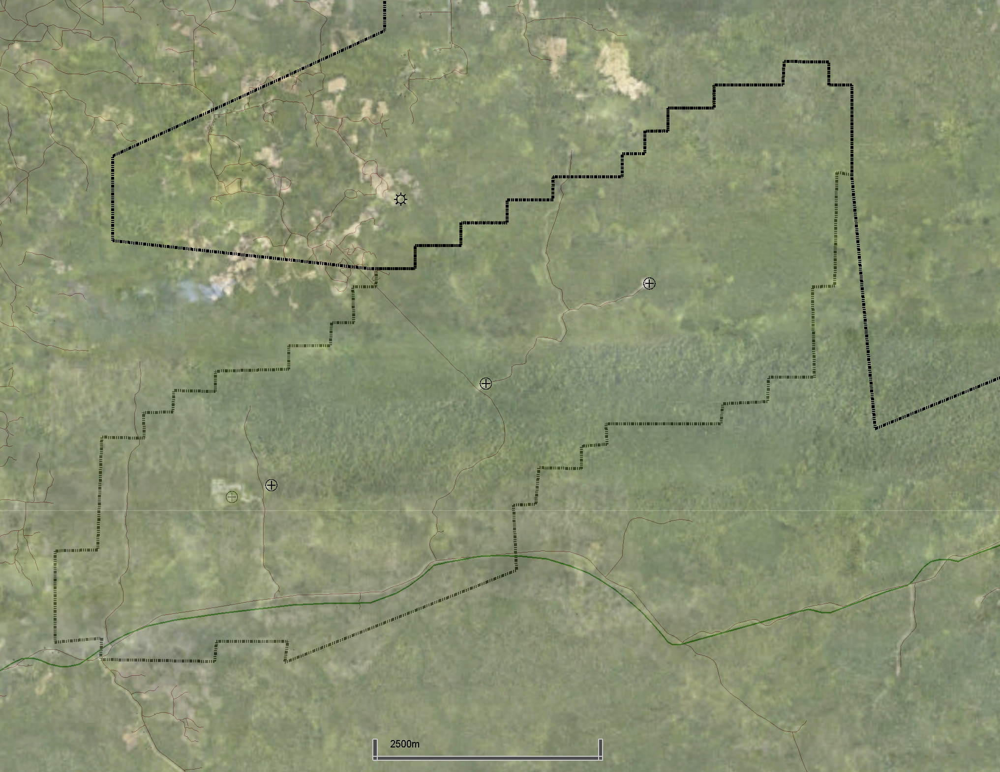
2025 ACQUISITION: Central Block (Shell)
Central Block
100% Operated
65% Working Interest
35% Heritage Petroleum (HPCL)
6,699 acres (4,354 net)
Liquids sales to HPCL
Multiple Gas Sales Options
  Pipeline to LNG Markets
  Pipeline to Domestic Markets
Coho gas volumes are currently processed through the Evergreen Facility
Ortoire
COHO-1
Central Block
BRE-1
BR-1
CR-2
CR-1
Evergreen Gas Facility

Slide 14
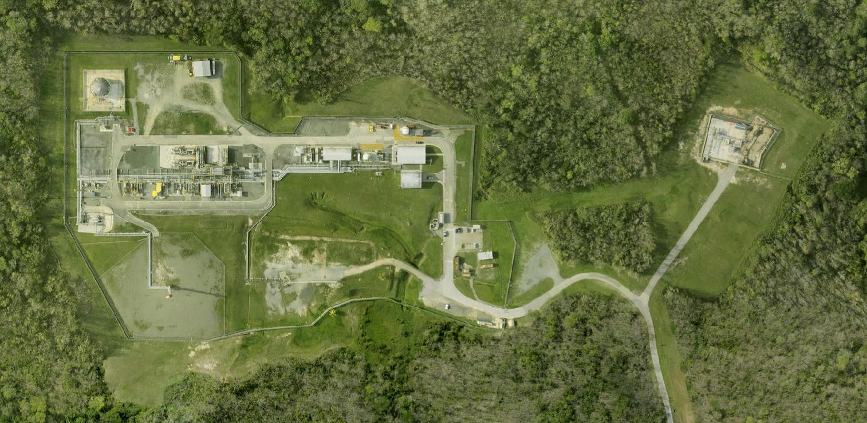

2025 ACQUISITION: Central Block (Shell)
Central Block
Evergreen Gas Plant
Carapal Ridge-1 (CR-1)
Carapal Ridge-2 (CR-2)
Baraka-1 (BR-1)
Baraka East-1 (BRE-1)
Evergreen Gas Facility
CR-2
CR-1
CIPERO
Cascadura
ORTOIRE
Coho
Evergreen Gas Facility
Built by BG and Commissioned in 2007
80 mmscf/d Capacity
10,000 bbls Condensate Capacity
Pipeline connected to LNG and Domestic Markets
BRE-1
BR-1
CR-1
CR-2
CENTRAL BLOCK

Slide 15

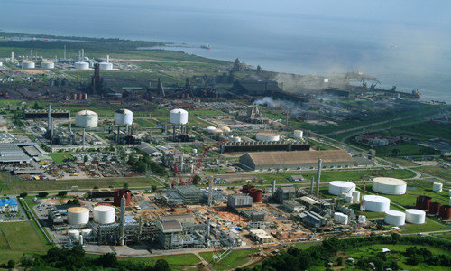

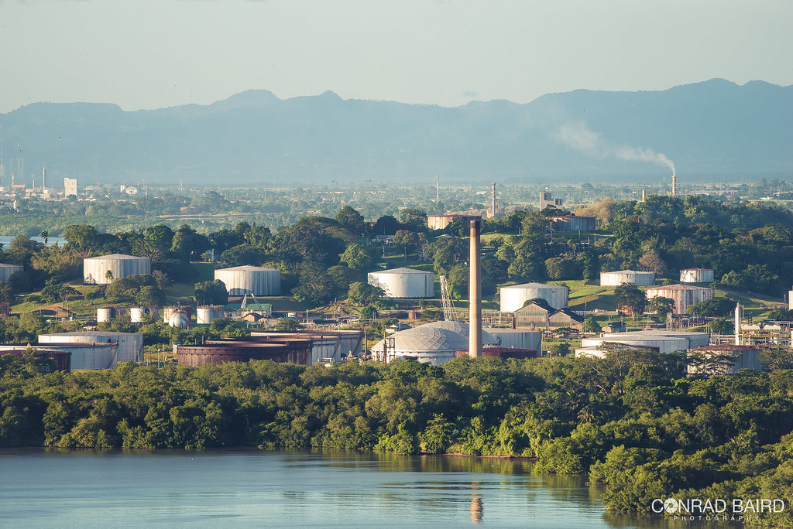




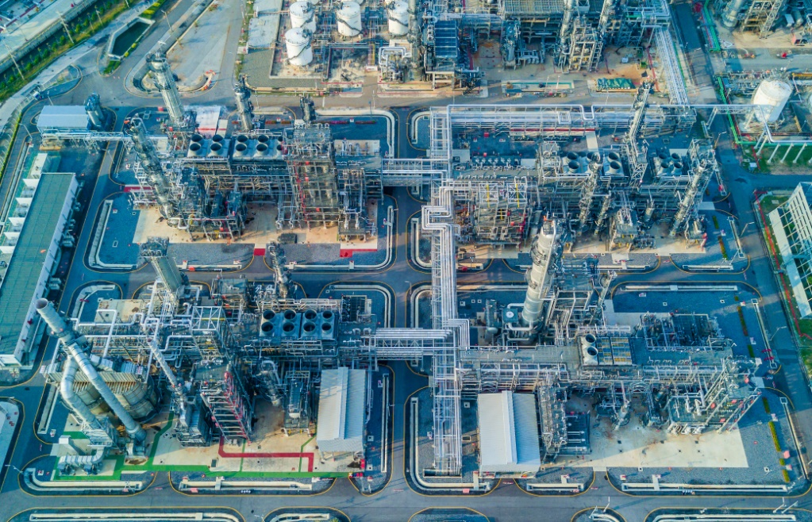
Distribution and Marketing: We have the market
Point Lisas
Petrochemical facilities
Potash Corp and Yara - Ammonia
Methanex – Methanol
Arcelor Mittal – Steel
Trinidad and Tobago
4 Bcf/d total
potential demand
Pointe-A-Pierre – HPCL
Oil storage facility
Liquids distribution port
Domestic Market
Cascadura
Point Fortin – Atlantic LNG
Liquified Natural Gas (LNG) terminal
Four-train liquefaction facility
100,000 cubic-meter per day capacity
Coho
Central Block

Slide 16


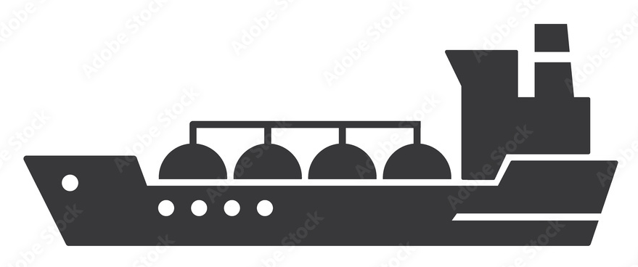
Shell Acquisition: Expands our access to the market
Marketing Agreements
Ortoire
Gas: Domestic Market
Oil: HPCL
Point Lisas
Petrochemical facilities
Potash Corp - Ammonia
Methanex – Methanol
Arcelor Mittal – Steel
Rio Claro, Cipero, Charuma
Gas: Uncontracted
Oil: Uncontracted (HPCL)
Pointe-A-Pierre – HPCL
Oil storage facility
Liquids distribution port
Domestic Market
Central Block
Gas: LNG Markets, or
Domestic Market
Oil: HPCL
Domestic Market
Cascadura
LNG Market
Coho
Point Fortin – Atlantic LNG
Liquified Natural Gas (LNG) terminal
Four-train liquefaction facility
100,000 cubic-meter per day capacity
Central Block

Slide 17
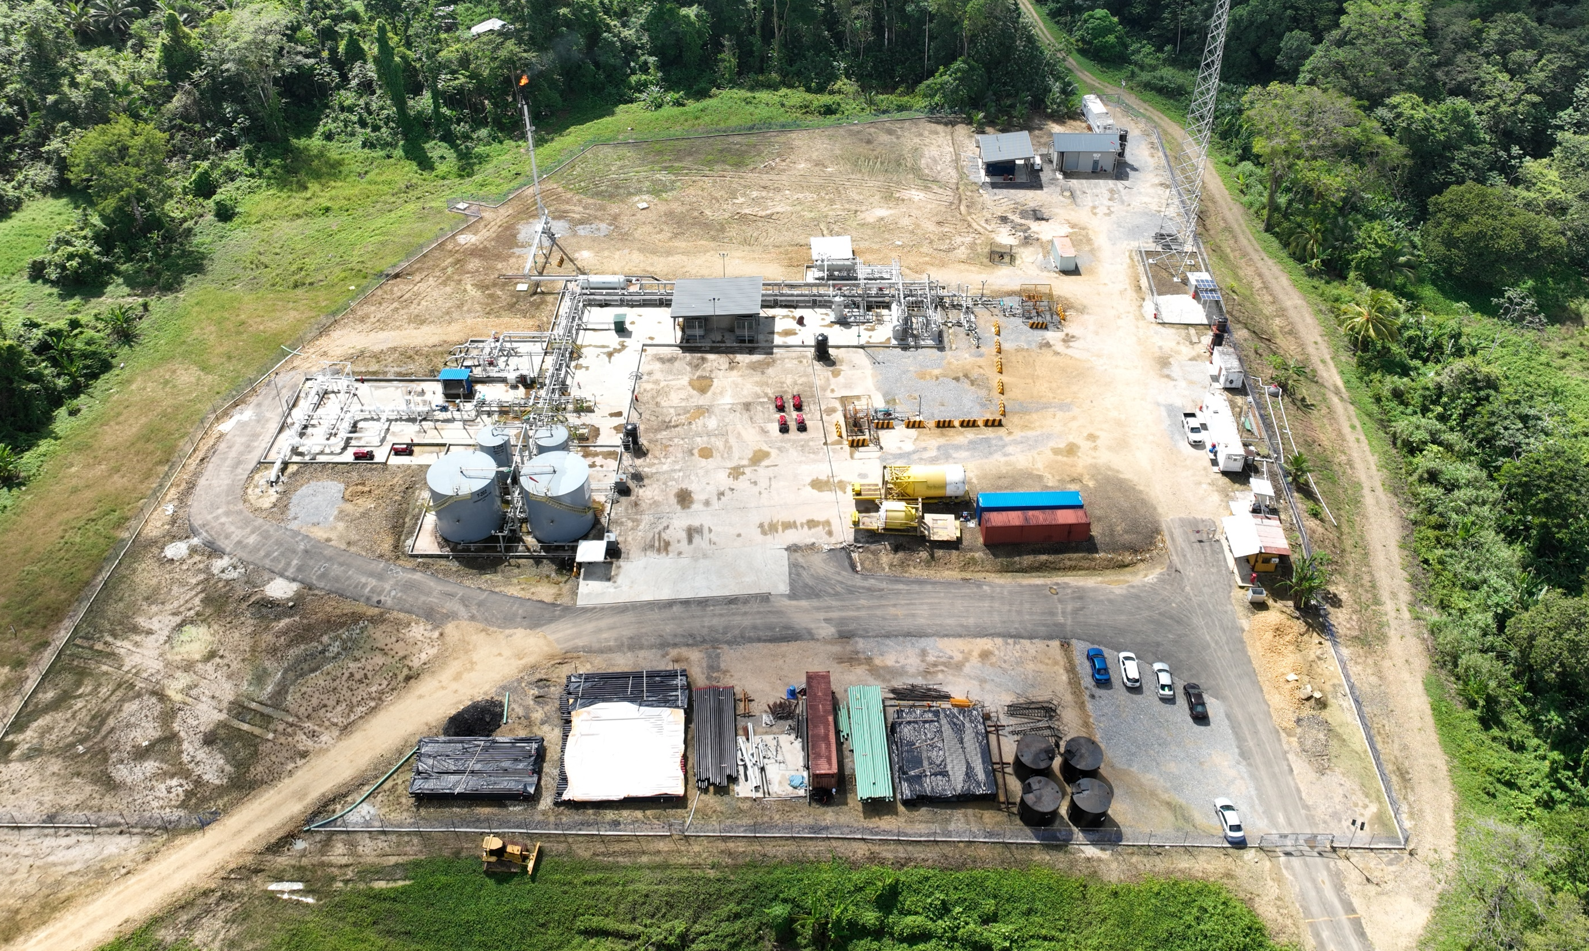
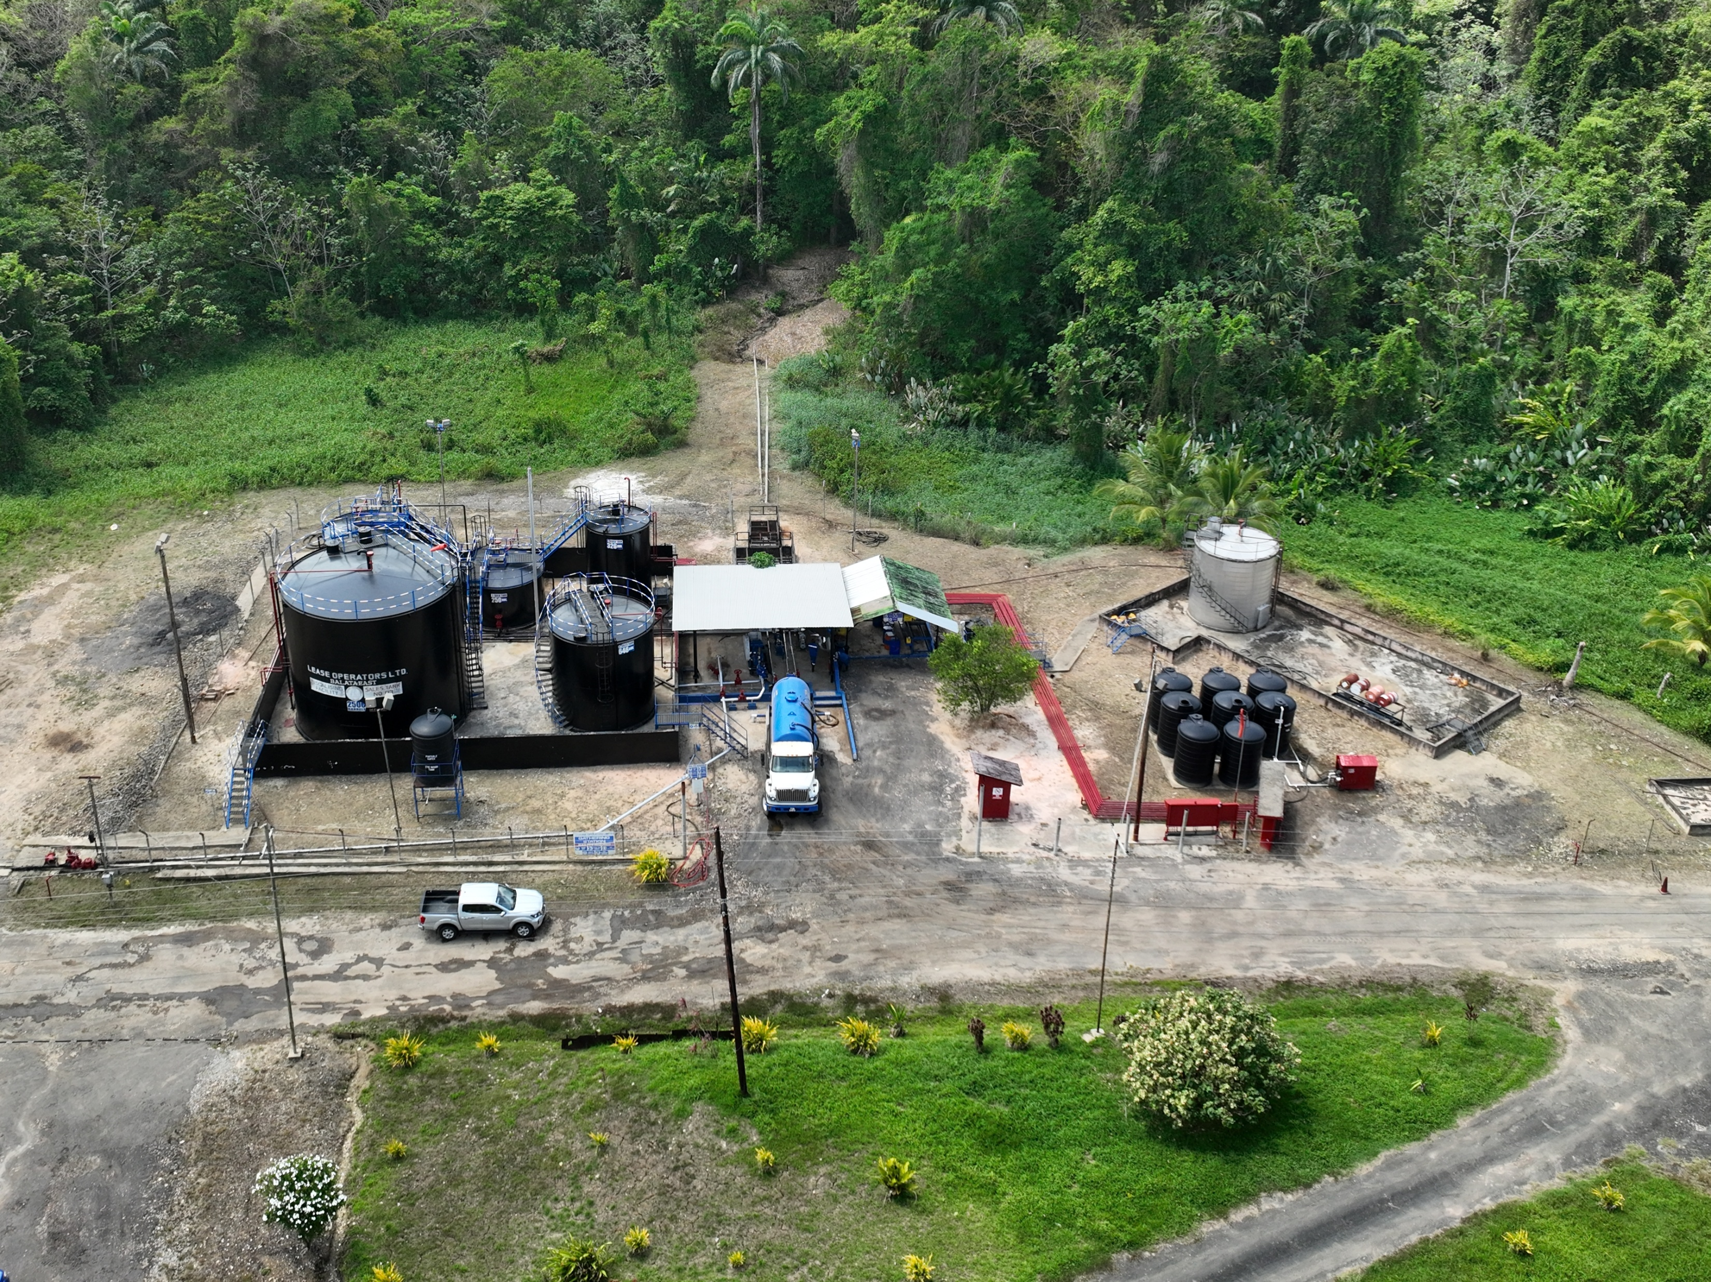
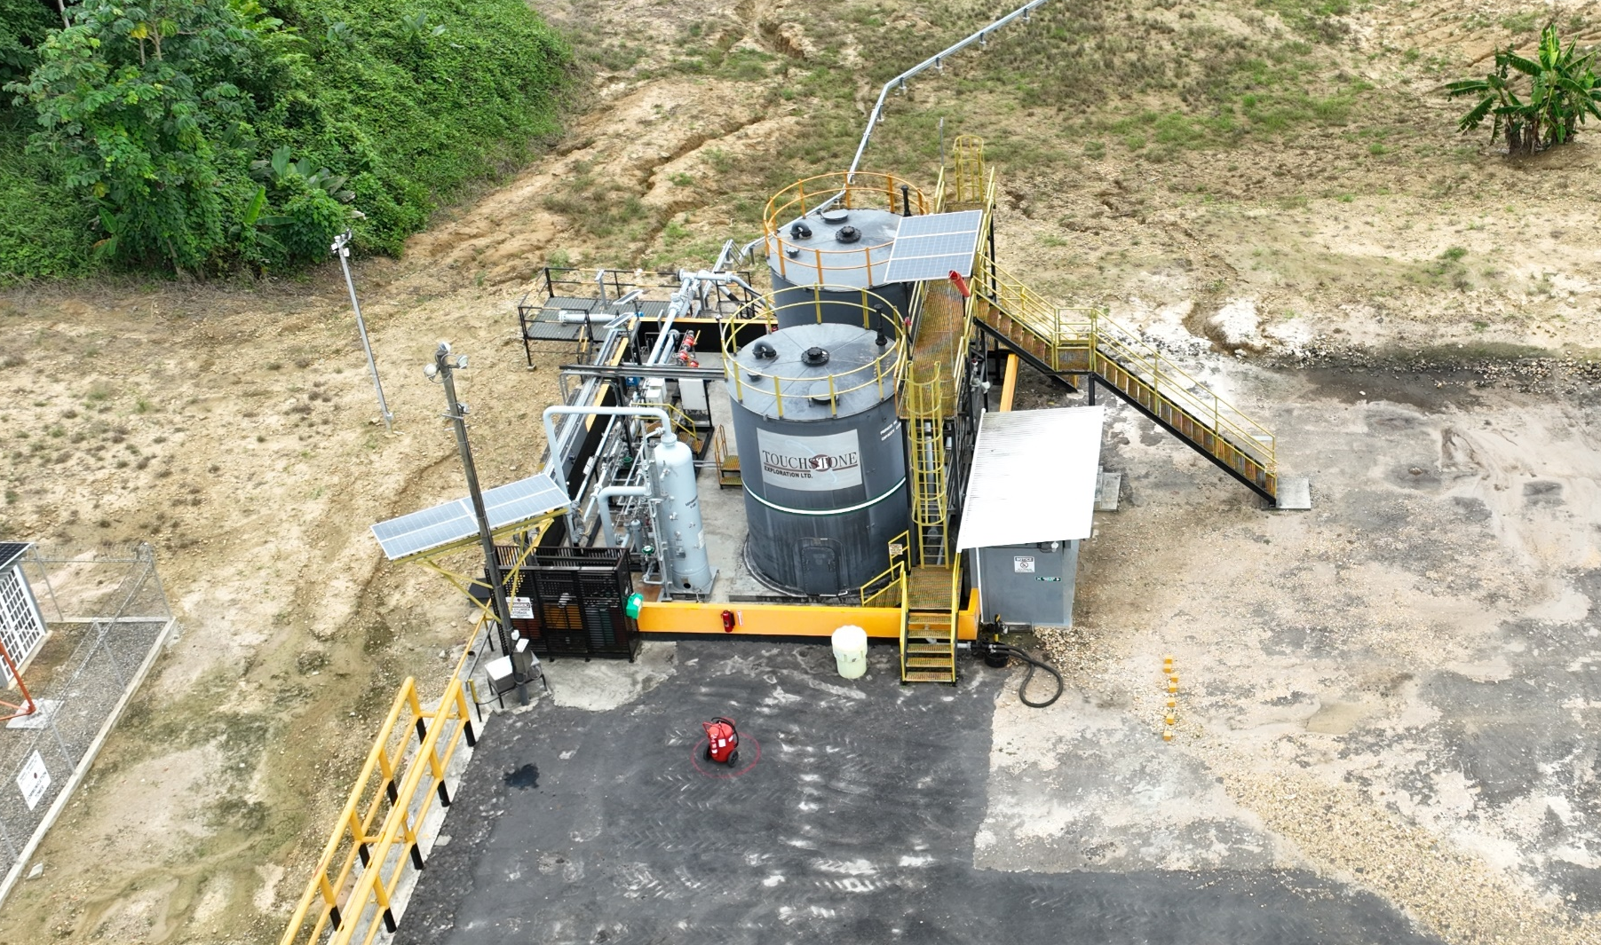
Facilities: We have the capacity
Balata East
Oil battery
Sales point for Cascadura liquids
6” sales pipeline (~18 km.)
600 bbls processing; 2,500 bbls sales
Two Operated Natural Gas Plants
  Cascadura 140 MMcf/d natural gas capacity 4,000 bbls liquids storage
  Coho 24 MMcf/d natural gas capacity
Six Operated Oil Batteries
  Four Core 17,450 bbls
Cascadura A Natural Gas Facility
Commissioned September 2023
Facility expansion November 2024:
140 MMcf/d natural gas capacity
4,000 bbls NGL storage
800 bbls water storage
Coho Natural Gas Facility
Commissioned October 2022
24 MMcf/d natural gas capacity
800 bbls liquids storage
Total Current Capacity
48,783 boe/d
2025 Central Block Acquisition
  Evergreen 80 MMcf/d natural gas capacity 10,000 bbls liquids storage
Total Pro Forma Capacity 72,117 boe/d
Evergreen (Central Block)
Commissioned August 2007
80 MMcf/d natural gas capacity
10,000 bbls liquids storage
WD-4
2,100 bbls processing
6,000 bbls sales
WD-8
1,300 bbls processing
750 bbls sales
CO-1
2,000 bbls processing
2,200 bbls sales

Slide 18

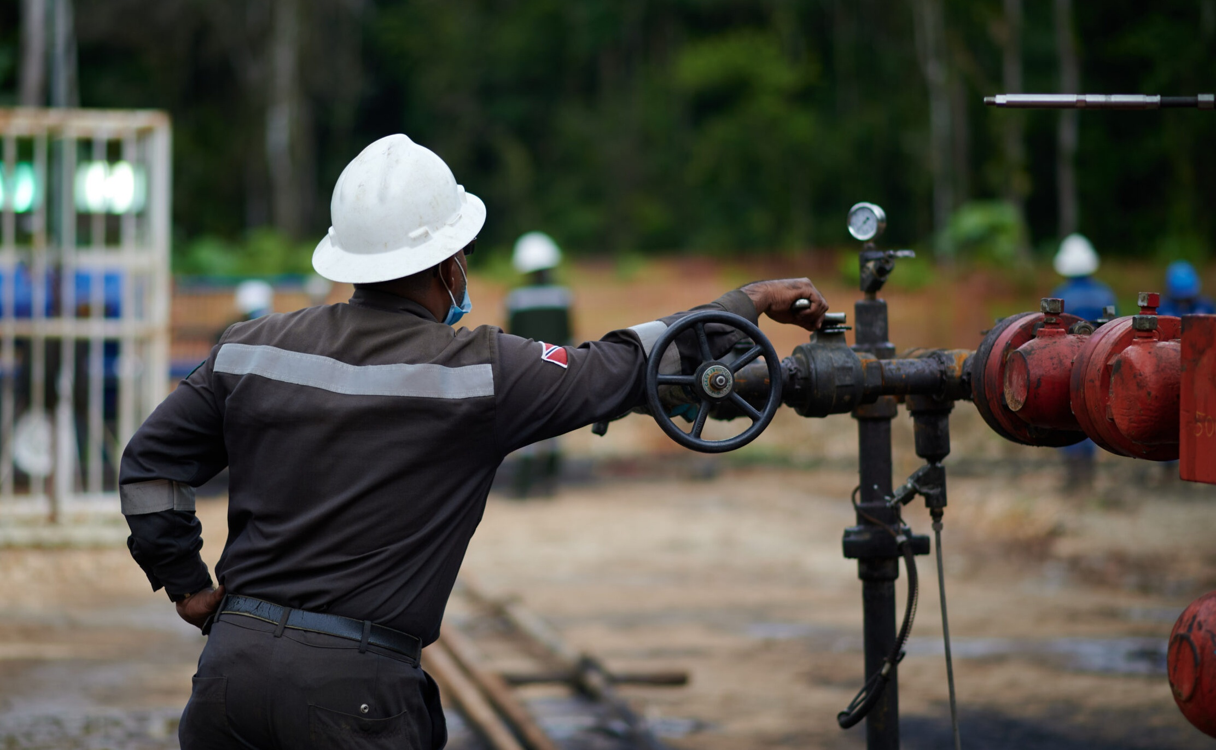





Three Pillars of Progress:
Fill. Grow. Future.
Drill to Fill
Drill for Growth
Drill for the Future
      We are filling capacity by harnessing the potential of Coho and Cascadura, delivering resources efficiently and reliably to support our growth.
      Our legacy oil blocks continue to thrive, growing production through recompletions and optimizations, ensuring we build on our strong foundation.
      With eyes on exploration, we are breaking new ground in Ortoire, Charuma, Cipero and Rio Claro, paving the way for tomorrow's energy through innovative development.

Slide 19


2024: Investing in resource-rich assets
Disciplined investment framework to establish a future with sustainable free cash flow
Herrera
Cretaceous
Nariva
Charuma
Existing production
Rio Claro
Cipero
Balata East
Ortoire
WD-8
WD-4
CO-1

Slide 20
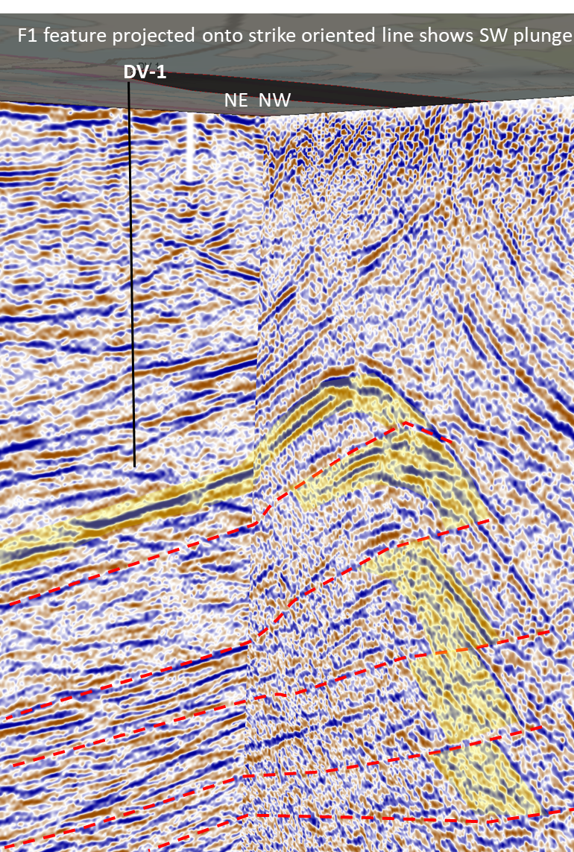
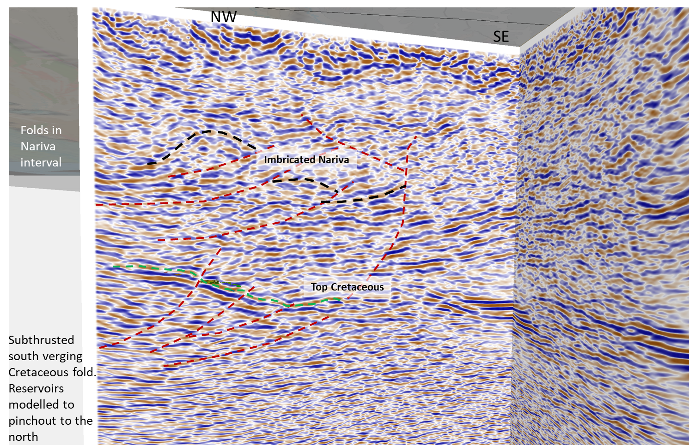
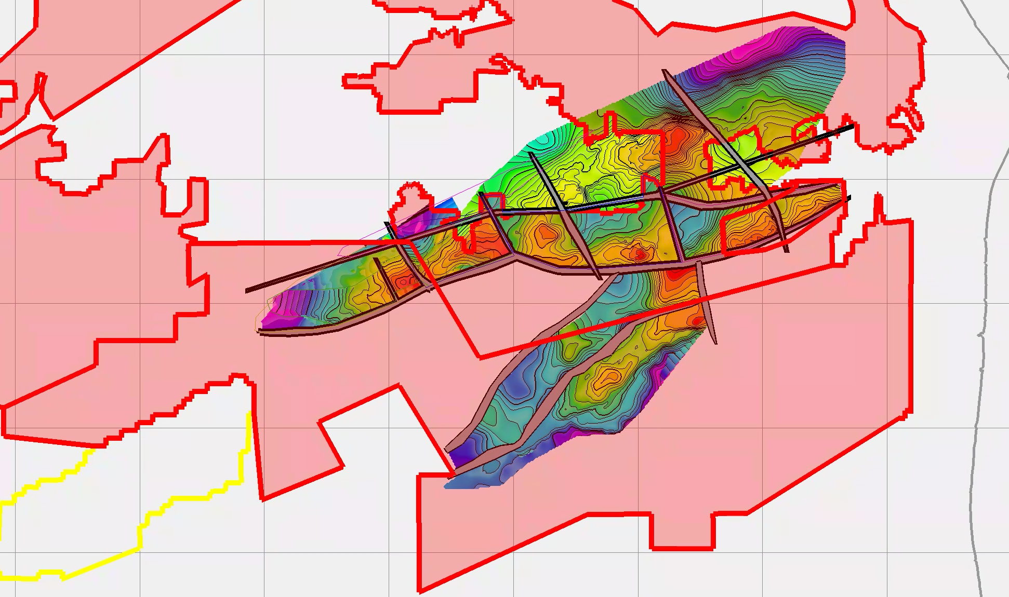
Drill for the Future: New Exploration Acreage
CIPERO
CHARUMA
RIO CLARO
CHARUMA
RIO CLARO
Balata East
CIPERO
Cascadura
Coho
Royston
Central Block
Exploration prospects in the Nariva sands target depths from 2,000 to 5,000 feet and in Cretaceous sands at c. 7,000 feet
ORTOIRE
Step-out prospects in the Herrera sands updip of discoveries at Cascadura and Royston
Exploration prospects in
the Herrera and Nariva sands target depths from
4,000 to 8,000 feet
Exploration prospects in the Retrench and Herrera sands target depths from 4,500 to 10,000 feet as well as Cretaceous sands at c. 13,500 feet
Exploration prospects in the Cretaceous sands with target depths of 13,000 feet and deeper

Slide 21
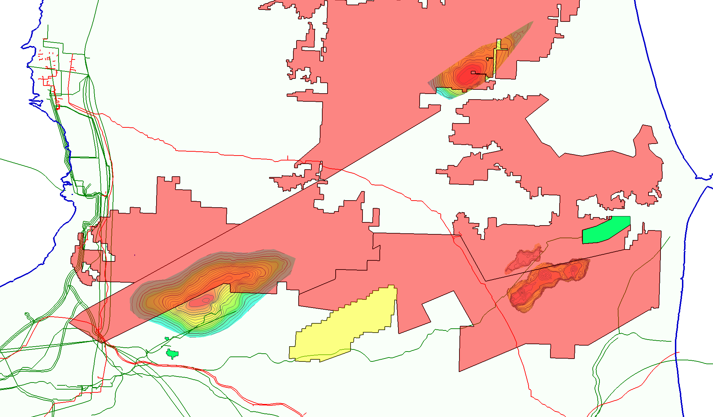
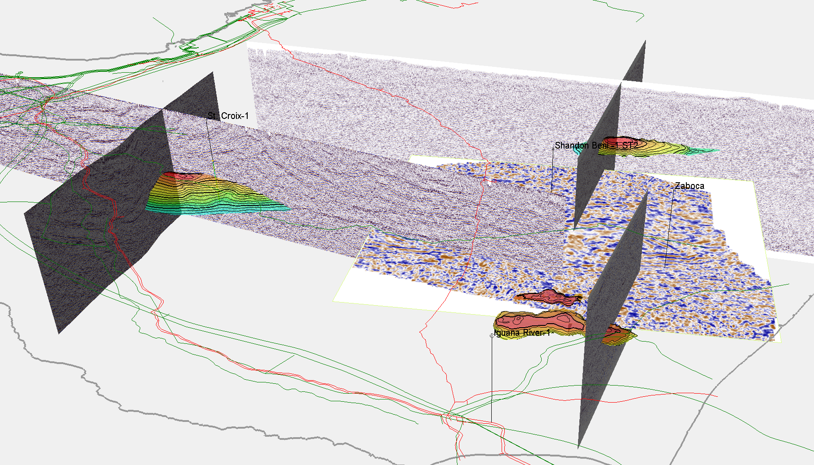
Drill for the Future: Cretaceous exploration
Touchstone has identified multiple Cretaceous anomalies on our exploration blocks which have the potential to unlock a new onshore play type with ties to offshore discoveries near Guyana
Cocos
CHARUMA
COCOS
c. 7,000 feet
RIO CLARO
CHARUMA
CIPERO
ST. CROIX
c. 13,000 feet
ORTOIRE
Kraken
KRAKEN
c. 15,000 feet
St. Croix
1993
Exxon's RP-1 drilled to 16,006 feet and tested gas in sandstone
1994
Exxon's IGR-1 drilled to 12,762 feet and encountered residual oils in sandstones and carbonates
1995
Exxon's SCRX-1 drilled to 17,587 feet and encountered residual oil in sandstones
2005
Talisman's Zaboca-1 drilled to 15,681 feet and did not encounter sandstones
2006
Talisman's Shandon Beni-1 drilled to 14,616 feet and encountered residual oil in sandstones
2015
Liza-1 Cretaceous discovery by ExxonMobil, offshore Guyana

Slide 22

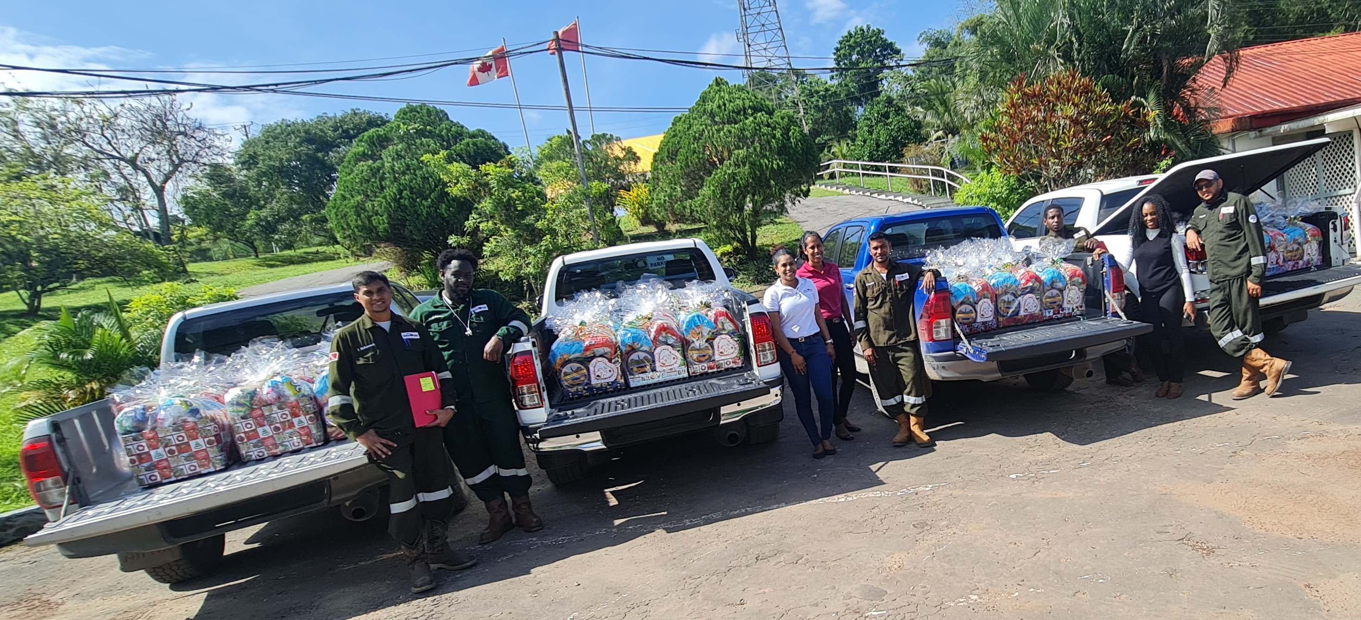


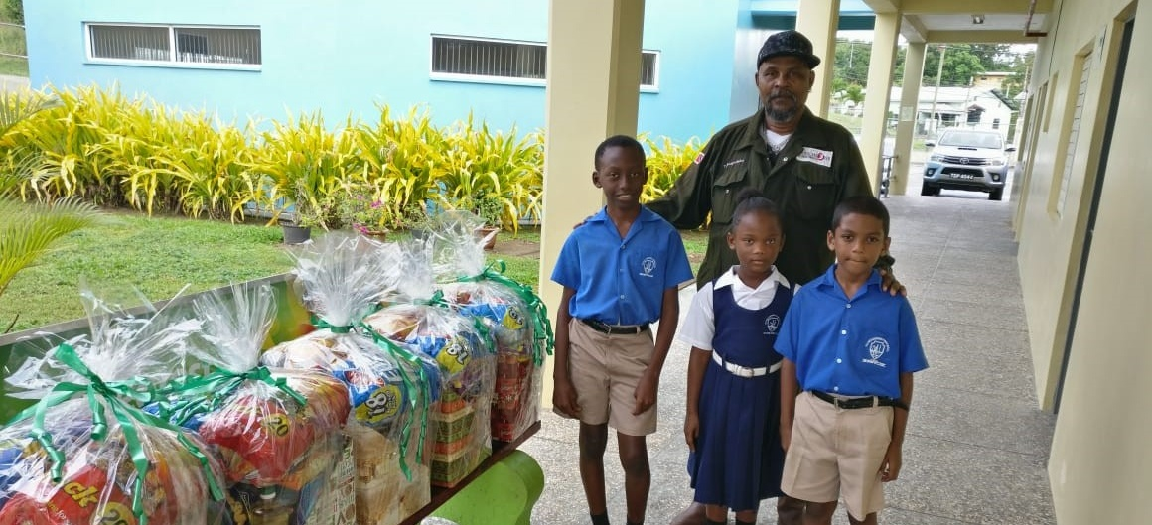
Social and Governance
Improving our long-term success by considering our impact on the communities we operate in
Social
Governance
  2
  lost time incidents
  in over 3 years
  83%
  local
  workforce
  $15.2MM
of local procurement
in 2022
  33%
female representation
on the Board
  89%
independent
board members
  100%
employees re-certified on our
Code of Conduct and Ethics

Slide 23

Investment Case: Why Touchstone Exploration Inc.
48,783 boe/d processing capacity
2P gross reserves 67.4 MMboe⁽²⁾
229 identified drilling locations across several large high-quality reservoirs⁽¹⁾
Trusted partner with government and industry
Robust domestic demand and supply deficit
Fixed-price gas contract providing stability and certainty
Pursuing accretive acquisitions to further expand asset base
Notes:
See "Advisories: Drilling Locations".
Based on the December 31, 2023 GLJ Ltd. independent reserves evaluation. See "Advisories: Oil and Gas Reserves" and "Advisories: Oil and Gas Measures".
Notes:
See "Advisories: Drilling Locations".
Non-GAAP financial or other measure. Refer to "Advisories: Non-GAAP Financial Measures".
Based on the December 31, 2023 GLJ Ltd. independent reserves evaluation. See "Advisories: Oil and Gas Reserves" and "Advisories: Oil and Gas Measures".

Slide 24

Corporate Information and Contacts
Contacts
Paul R. Baay
President and Chief Executive Officer
pbaay@touchstoneexploration.com
(403) 750-4488
Scott Budau
Chief Financial Officer
sbudau@touchstoneexploration.com
(403) 750-4445
Brian Hollingshead
Executive Vice President, Engineering and Business Development bhollingshead@touchstoneexploration.com
(403) 750-4450
James Shipka
Executive Vice President Asset Development and HSSE
jshipka@touchstoneexploration.com
(403) 750-4455
Office Locations
Head Office
Suite 4100, 350 7th Ave SW
Calgary, AB T2P 3N9
Office: (403) 750-4400
Website: www.touchstoneexploration.com
Fax: (403) 266-5794
info@touchstoneexploration.com
Trinidad Offices
Touchstone Exploration (Trinidad) Ltd.
Unit 416A, South Park Plaza
Tarouba Link Road
San Fernando, Trinidad
Office: (868) 218-7411
Primera Oil and Gas Limited
14 Sydney Street
Rio Claro, Trinidad
Office: (868) 677-7411
Stock Exchange Listing
TSX: TXP
AIM: TXP
Year-end
December 31
Banker
Republic Bank Limited
Auditor
KPMG LLP
Reserves Evaluator
GLJ Ltd.
Legal Counsel
Norton Rose Fulbright LLP
Transfer Agents
Odyssey Trust Company
Link Group

Slide 25

Abbreviations
bbl(s) barrel(s)
bbls/d barrels per day
Mbbls thousand barrels
MMbbls million barrels
Mcf thousand cubic feet
Mcf/d thousand cubic feet per day
MMcf million cubic feet
MMcf/d million cubic feet per day
Bcf billion cubic feet
Bcf/d billion cubic feet per day
MMBtu million British Thermal Units
boe barrels of oil equivalent
boe/d barrels of oil equivalent per day
Mboe thousand barrels of oil equivalent
MMboe million barrels of oil equivalent
PDP proved developed producing reserves
1P proved reserves
2P proved plus probable reserves
3P proved plus probable plus possible reserves
AIM AIM market of the London Stock Exchange plc
Brent dated Brent
HPCL Heritage Petroleum Company Limited
NGC The National Gas Company of Trinidad and Tobago Limited
NGL(s) natural gas liquid(s)
psi pounds per square inch
psig pound force per square inch
TSX Toronto Stock Exchange
$C Canadian dollars
$MM million dollars
$ or US$ United States dollars

Slide 26

Advisories
This presentation is for information purposes only and is not under any circumstances to be construed as a prospectus or an advertisement for a public offering of such securities. No securities commission or similar authority in Canada or elsewhere including the TSX has in any way passed upon this presentation, or the merits of any securities of Touchstone Exploration Inc., and any representation to the contrary is an offence. An investment in Touchstone Exploration Inc.'s securities should be considered highly speculative due to the nature of the proposed involvement in the exploration for and production of petroleum and natural gas. This presentation and the information contained herein do not constitute an offer to sell or a solicitation of an offer to buy any securities in the United States. The securities of Touchstone Exploration Inc. have not been registered under the United States Securities Act of 1933, as amended (the "U.S. Securities Act") or any state securities laws and may not be offered or sold within the United States or to U.S. Persons unless registered under the U.S. Securities Act and applicable state securities laws or an exemption from such registration is available.
Currency
Unless otherwise stated, all financial amounts herein are presented in United States dollars. The Company may also reference Canadian dollars ("C$"), Trinidad and Tobago dollars ("TT$") and Pounds Sterling ("£") herein.
Production Volumes
Unless otherwise stated, all production volumes disclosed herein are sales volumes before royalty burdens.
Forward-looking Statements
Certain information regarding Touchstone Exploration Inc. ("Touchstone", "we", "our", "us", or the "Company") set forth in this presentation may constitute forward-looking statements and information (collectively, "forward-looking statements") within the meaning of applicable securities laws. Such forward-looking statements include, without limitation, forecasts, estimates, expectations and objectives for future operations that are subject to assumptions, risks and uncertainties, many of which are beyond the control of the Company. Forward-looking statements are statements that are not historical facts and are generally, but not always, identified by the words "expect", "plan", "anticipate", "believe", "intend", "maintain", "continue to", "pursue", "design", "result in", "sustain" "estimate", "potential", "growth", "near-term", "long-term", "forecast", "contingent" and similar expressions, or are events or conditions that "will", "would", "may", "could" or "should" occur or be achieved. The forward-looking statements contained in this presentation speak only as of the date hereof and are expressly qualified by this cautionary statement.
Forward-looking statements in this presentation include, but are not limited to, those in respect of: the Company's business plans, strategies, priorities, goals and long-term plans; potential acquisition opportunities within Trinidad; the potential for future shareholder returns; exploration, development and production opportunities and activities, including anticipated, drilling, drilling locations, production testing, development, tie-in, facilities construction, and ultimate production and production rates from exploration and development wells; opportunities to increase production through well optimization and enhanced oil recovery projects; the quality and quantity of prospective hydrocarbon accumulations based on wireline logs, including the Company's interpretations thereof; the Company's expectation of future funds flow from operations and capital expenditures and the amount thereof; the Company's future exploration activities; the extent to which local communities will benefit from the Company's operations; general business strategies and objectives; Touchstone's ability to pursue development opportunities that generate positive returns and position it for success; the focus of Touchstone's future capital plans, including pursuing developmental drilling activities and optimizing existing natural gas and liquids infrastructure capacity; anticipated future production and production by commodity; forecasted production decline rates; anticipated timing of developmental and exploration drilling production; expected drilling activities, including locations and the timing thereof; anticipated timing of well tie-in operations; anticipated funds flow from operations and net debt; field estimated production; and Touchstone's current and future financial position, including the sufficiency of resources to fund future capital expenditures and maintain financial liquidity.
The Company's actual decisions, activities, results, performance, or achievement could differ materially from those expressed in, or implied by, such forward-looking statements and accordingly, no assurances can be given that any of the events anticipated by the forward-looking statements will transpire or occur or, if any of them do, what benefits that Touchstone will derive from them.

Slide 27
Advisories
Forward-looking Statements (continued)
With respect to forward-looking statements contained in this presentation, the Company has made assumptions regarding: financial condition; outlook and results of operations; exploration, development and associated operational plans (including drilling, testing, facilities construction and recompletion programs) and the anticipated costs and timing thereof; estimated oil and gas reserves (including the magnitude, ability to recover, commerciality and net present value thereof); production rates and production decline rates; net feet of pay based on internal estimates of wireline logs; the success of exploration opportunities; plans for and results of production testing and anticipated initial production rates derived therefrom; the ability to secure necessary personnel, equipment, production licences, regulatory approvals and services; environmental matters; future commodity prices; changes to prevailing regulatory, royalty, tax and environmental laws and regulations; the impact of competition, future capital and other expenditures (including the amount, nature and sources of funding thereof); future financing sources; business prospects and opportunities; the impact ongoing geopolitical issues will have on the Company's future operations and future petroleum pricing; and safety related metrics and goals, among other things.
In addition, statements relating to reserves are by their nature forward-looking statements, as they involve the implied assessment, based on certain estimates and assumptions, that the reserves described exist in the quantities predicted or estimated, and can be profitably produced in the future. The recovery and reserve estimates of Touchstone's reserves provided herein are estimates only, and there is no guarantee that the estimated reserves will be recovered. Consequently, actual results may differ materially from those anticipated in the forward-looking statements.
Since forward-looking statements address future events and conditions, by their very nature they involve inherent risks and uncertainties. Actual results could differ materially from those currently anticipated due to a number of factors and risks. New factors emerge from time to time, and it is not possible for Management to predict all of such factors and to assess in advance the impact of each such factor on Touchstone's business or the extent to which any factor, or combination of factors, may cause actual results to differ materially from those contained in any forward-looking statements. Although the Company believes that the expectations and assumptions on which the forward-looking statements are based are reasonable, undue reliance should not be placed on the forward-looking statements because the Company can give no assurance that they will prove to be correct. Some of the risks that could affect the Company's future results and could cause results to differ materially from those expressed in the forward-looking information are described under the heading "Advisories: Business Risks" in this presentation and are also set out in more detail in the Company's 2023 Annual Information Form dated March 20, 2024, which has been filed on SEDAR+ and can be accessed at www.sedarplus.ca.
Touchstone's actual results, performance or achievement could differ materially from those expressed in, or implied by, the forward-looking information and, accordingly, no assurance can be given that any of the events anticipated by the forward-looking information will transpire or occur, or if any of them do so, what benefits that we will derive therefrom. Management has included the above summary of assumptions and risks related to forward-looking information provided in this presentation in order to provide security holders with a more complete perspective on our future operations and such information may not be appropriate for other purposes.
Investors should not place undue reliance on any such forward-looking statements. Further, any forward-looking statement or information speaks only as of the date on which such statement is made, and Touchstone undertakes no obligation or intent to update any forward-looking statements or information except as required by law, including securities laws. All forward-looking statements contained in this presentation are qualified by such cautionary statements.
Business Risks
The Company is exposed to numerous operational, technical, financial and regulatory risks and uncertainties, many of which are beyond its control and may significantly affect anticipated future results. The Company is exposed to risks associated with negotiating with foreign governments as well as country risk associated with conducting international activities. Operations may be unsuccessful or delayed as a result of competition for services, supplies and equipment, mechanical and technical difficulties, ability to attract and retain qualified employees on a cost-effective basis, commodity and marketing risk. The Company is subject to significant drilling risks and uncertainties including the ability to find oil and natural gas reserves on an economic basis and the potential for technical problems that could lead to well blow-outs and environmental damage. The Company is exposed to risks relating to the inability to obtain timely regulatory approvals, surface access, access to third-party gathering and processing facilities, transportation and other third-party related operation risks.

Slide 28
Advisories
Business Risks (continued)
The Company is subject to industry conditions including changes in laws and regulations, including the adoption of new environmental laws and regulations and changes in how they are interpreted and enforced. There are uncertainties in estimating the Company's reserve and resource base due to the complexities in estimated future production, costs and timing of expenses and future capital. The Company is subject to the risk that it will not be able to fulfill the contractual obligations required to retain its rights to explore, develop and exploit any of its properties. The financial risks the Company is exposed to include, but are not limited to, the impact of general economic conditions in Canada, the United Kingdom and Trinidad, continued volatility in market prices for oil and natural gas, the impact of significant declines in market prices for oil and natural gas, the ability to access sufficient capital from internal and external sources, changes in income tax laws, royalties and incentive programs relating to the oil and natural gas industry, fluctuations in interest rates, the C$ to US$ exchange rate and the US$ to TT$ exchange rate. The Company is subject to local regulatory legislation, the compliance with which may require significant expenditures and non-compliance with which may result in fines, penalties or production restrictions or the termination of licence or other rights related to the Company's oil and natural gas interests in Trinidad. Readers are cautioned that the foregoing list of factors is not exhaustive. Certain of these risks are set out in more detail in the Company's 2023 Annual Information Form dated March 20, 2024 which has been filed on SEDAR+ and can be accessed at www.sedarplus.ca.
Oil and Gas Reserves
All reserves references herein are Company gross reserves. Gross reserves are the Company's working interest share before deduction of royalties. Net reserves are the Company's working interest share after the deduction of royalty obligations.
The December 31, 2023 reserves information included herein are based on the Company's December 31, 2023 independent reserve report prepared by Touchstone's independent reserves evaluator, GLJ Ltd. ("GLJ"), dated March 1, 2024. The report was prepared in accordance with definitions, standards and procedures contained in the Canadian Oil and Gas Evaluation Handbook ("COGEH") and National Instrument 51-101 Standards of Disclosure for Oil and Gas Activities ("NI 51-101"). All December 31, 2023 reserves presented are based on the average price forecasts of the three leading Canadian oil and gas evaluation consultants (GLJ, McDaniel & Associates Consultants Ltd. and Sproule Associates Ltd.) dated January 1, 2024 and estimated costs effective December 31, 2023. The disclosure in this presentation summarizes certain information contained in the reserves report but represents only a portion of the disclosure required under NI 51-101. Full disclosure with respect to the Company's reserves as at December 31, 2023 are included in the Company's 2023 Annual Information Form dated March 20, 2024 which has been filed on SEDAR+ and can be accessed at www.sedarplus.ca.
The recovery and reserve estimates of crude oil, natural gas and NGL reserves provided herein are estimates only, and there is no guarantee that the estimated reserves will be recovered. Actual reserves may eventually prove to be greater than or less than the estimates provided herein. This presentation may summarize the crude oil, natural gas and NGL reserves of the Company and the net present values of future net revenue for such reserves using forecast prices and costs prior to provision for interest and finance costs, general and administration expenses, and the impact of any financial derivatives. It should not be assumed that the present worth of estimated future net revenues presented herein represent the fair market value of the reserves. There is no assurance that the forecast prices and costs assumptions will be attained, and variances could be material.
The reserves information for the Company's December 31, 2022 independent reserve report have been prepared by Touchstone's independent reserves evaluator, GLJ, dated March 3, 2023. The report was prepared in accordance with definitions, standards and procedures contained in the COGEH and NI 51-101. All December 31, 2022 reserves presented are based on GLJ's forecast pricing dated January 1, 2023 and estimated costs effective December 31, 2022. Additional reserves information as required under NI 51-101 are included in the Company's 2022 Annual Information Form dated March 23, 2023.
The reserves information for the Company's December 31, 2021 independent reserve report have been prepared by Touchstone's independent reserves evaluator, GLJ, dated March 4, 2022. The report was prepared in accordance with definitions, standards and procedures contained in the COGEH and NI 51-101. All December 31, 2021 reserves presented are based on GLJ's forecast pricing dated January 1, 2022 and estimated costs effective December 31, 2021. Additional reserves information as required under NI 51-101 are included in the Company's 2021 Annual Information Form dated March 25, 2022.

Slide 29
Advisories
Oil and Gas Reserves (continued)
The reserves information for the Company's December 31, 2020 independent reserve report have been prepared by Touchstone's independent reserves evaluator, GLJ, dated March 4, 2021. The report was prepared in accordance with definitions, standards and procedures contained in the COGEH and NI 51-101. All December 31, 2020 reserves presented are based on GLJ's forecast pricing dated January 1, 2021 and estimated costs effective December 31, 2020. Additional 2020 reserves information, as required under NI 51-101 are included in the Company's 2020 Annual Information Form dated March 25, 2021.
The reserves information for the Company's December 31, 2019 independent reserve report have been prepared by Touchstone's independent reserves evaluator, GLJ, dated March 6, 2020. The report was prepared in accordance with definitions, standards and procedures contained in the COGEH and NI 51-101. All December 31, 2019 reserves presented are based on GLJ's forecast pricing dated January 1, 2020 and estimated costs effective December 31, 2019. Additional reserves information as required under NI 51-101 are included in the Company's 2019 Annual Information Form dated March 25, 2020.
The reserves information for the Company's December 31, 2018 independent reserve report have been prepared by Touchstone's independent reserves evaluator, GLJ, dated March 6, 2019. The report was prepared in accordance with definitions, standards and procedures contained in the COGEH and NI 51-101. All December 31, 2018 reserves presented are based on GLJ's forecast pricing dated January 1, 2019 and estimated costs effective December 31, 2018. Additional reserves information as required under NI 51-101 are included in the Company's 2018 Annual Information Form dated March 26, 2019.
Oil and Gas Measures
To provide a single unit of production for analytical purposes, natural gas production has been converted mathematically to barrels of oil equivalent. We use the industry-accepted standard conversion of six thousand cubic feet of natural gas to one barrel of oil (6 Mcf = 1 bbl). The 6:1 boe ratio is based on an energy equivalent conversion method primarily applicable at the burner tip. It does not represent a value equivalency at the wellhead and is not based on either energy content or current prices. While the boe ratio is useful for comparative measures and observing trends, it does not accurately reflect individual product values and might be misleading, particularly if used in isolation. As well, given that the value ratio, based on the current price of crude oil to natural gas, is significantly different from the 6:1 energy equivalency ratio, using a 6:1 conversion ratio may be misleading as an indication of value.
Product Type Disclosures
This presentation includes references to crude oil, NGLs, natural gas, and average daily production volumes. Under NI 51-101, disclosure of production volumes should include segmentation by product type as defined in the instrument. In this document, references to "crude oil" refer to "light crude oil and medium crude oil" and "heavy crude oil" combined product types; references to "NGLs" refer to condensate; and references to "natural gas" refer to the "conventional natural gas" product type, all as defined in the instrument. In addition, references to “crude oil and liquids” herein include crude oil and NGLs. For further information, refer to the "Advisories: Product Type Disclosures" section of our Management's Discussion and Analysis for the three and nine months ended September 30, 2024, which is incorporated herein by reference, and available on SEDAR+ (www.sedarplus.ca).
Drilling Locations
This presentation discloses total drilling locations. Drilling locations are classified into three categories: (i) proved locations; (ii) probable locations; and (iii) unbooked locations. Proved locations and probable locations are derived from the Company's reserves evaluation of GLJ effective December 31, 2023 and account for locations that have associated proved, probable and/or possible reserves, as applicable. Unbooked locations are internal estimates based on the prospective acreage associated with the Company's assets and an assumption as to the number of wells that can be drilled based on industry practice and internal review. Unbooked locations do not have attributed reserves. Unbooked locations have been identified by Management as an estimation of potential multi-year development and exploration drilling activities based on evaluation of applicable geologic, seismic, engineering, production and reserves information. There is no certainty that the Company will drill all unbooked drilling locations, and if drilled there is no certainty that such locations will result in additional petroleum and gas reserves or production.

Slide 30
Advisories
Drilling Locations (continued)
The locations on which the Company will drill wells will ultimately depend upon the availability of capital, regulatory approvals, petroleum and natural gas prices, costs, actual drilling results, additional reservoir information that can be obtained and other factors. While certain of the unbooked drilling locations have been de-risked by drilling existing wells and historical wells drilled in relative close proximity to such unbooked drilling locations, other unbooked drilling locations are farther away from existing wells where Management has less information about the characteristics of the reservoir, and therefore there is more uncertainty whether wells will be drilled in such locations; and if drilled there is more uncertainty that such wells will result in additional oil and gas reserves or production.
Non-GAAP Financial Measures
This presentation makes reference to various non-GAAP financial measures, non-GAAP ratios, capital management measures and supplementary financial measures as such terms are defined in National Instrument 52-112 - Non-GAAP and Other Financial Measures Disclosure. Such measures are not recognized measures under Generally Accepted Accounting Principles ("GAAP") and do not have a standardized meaning prescribed by IFRS Accounting Standards as issued by the International Accounting Standards Board ("IFRS") and therefore may not be comparable to similar financial measures disclosed by other issuers. Readers are cautioned that the non-GAAP financial measures referred to herein should not be construed as alternatives to, or more meaningful than, measures prescribed by IFRS and they are not meant to enhance the Company's reported financial performance or position. These are complementary measures that are commonly used in the oil and natural gas industry and by the Company to provide shareholders and potential investors with additional information regarding the Company's performance, liquidity and ability to generate funds to finance its operations. For further information, refer to the "Advisories: Non-GAAP Financial Measures" section of our Management's Discussion and Analysis for the three and nine months ended September 30, 2024, which is incorporated herein by reference, and available on SEDAR+ (www.sedarplus.ca).
The Company uses operating netback as a key performance indicator of field results. The Company considers operating netback to be a key measure as it demonstrates Touchstone's profitability relative to current commodity prices and assists Management and investors with evaluating operating results on a historical basis. Operating netback is a non-GAAP financial measure calculated by deducting royalties and operating expenses from petroleum and natural gas sales. The most directly comparable financial measure to operating netback disclosed in the Company's consolidated financial statements is petroleum and natural gas revenue net of royalties. Operating netback per boe is a non-GAAP ratio calculated by dividing the operating netback by total sales volumes for the period. Presenting operating netback on a per boe basis allows Management to better analyze performance against prior periods on a comparable basis.
Market capitalization is a supplementary financial measure and is calculated as period end common share price multiplied by the number of common shares outstanding at the end of the period. Management believes that market capitalization provides a useful measure of the market value of Touchstone's equity.
Capital expenditures is a non-GAAP financial measure that is calculated as the sum of exploration and evaluation asset expenditures and property, plant and equipment expenditures included in the Company's consolidated statements of cash flows and is most directly comparable to cash used in investing activities. Touchstone considers capital expenditures to be a useful measure of its investment in its existing asset base.
Working capital and net debt are capital management measures used by Management to monitor the Company's capital structure to evaluate its true debt and liquidity position and to manage capital and liquidity risk. Working capital is calculated by subtracting current liabilities from current assets as they appear on the applicable consolidated balance sheet. Net debt is calculated by summing the Company's working capital and the principal (undiscounted) long-term amount of senior secured debt and is most directly comparable to total liabilities disclosed in the Company's consolidated balance sheets.
Net debt to funds flow from operations ratio is a non-GAAP ratio and a capital management measure calculated as the ratio of the Company’s net debt to trailing annual funds flow from operations. The net debt to funds flow from operations ratio is the desired target Touchstone strives to achieve and maintain.
Cash finance expenses are calculated as net finance expenses as determined in accordance with IFRS, less accretion on bank debt and accretion on decommissioning obligations, both of which are non-cash in nature. The Company discloses cash finance expenses to demonstrate the true cost of finance expenses to assist Management with evaluating results on a historical basis.

